Slide 1

Roadmap and Intro to Machine Learning
Abdullah Saihan
Artificial Intelligence Engineer

Slide 2
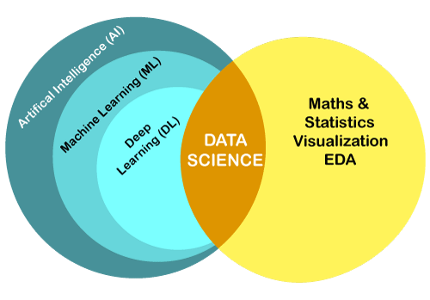
Data Science Vs AI/ML
➡️ Data science is about turning raw data into useful knowledge.
➡️Artificial intelligence teaches computers to act and decide like humans

Slide 3
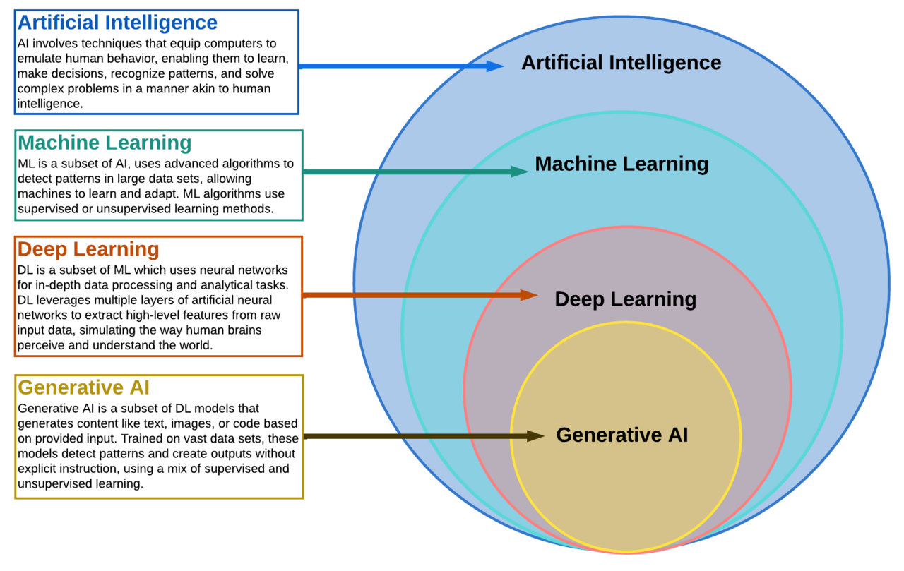
The AI landscape

Slide 4
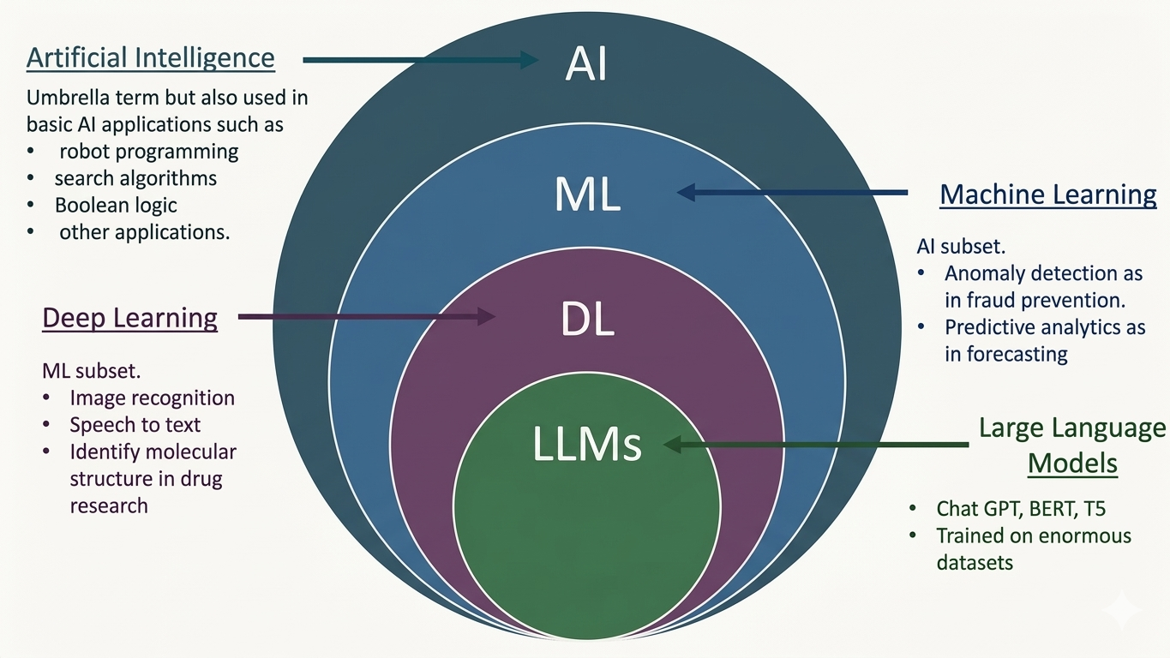
The AI landscape

Slide 5
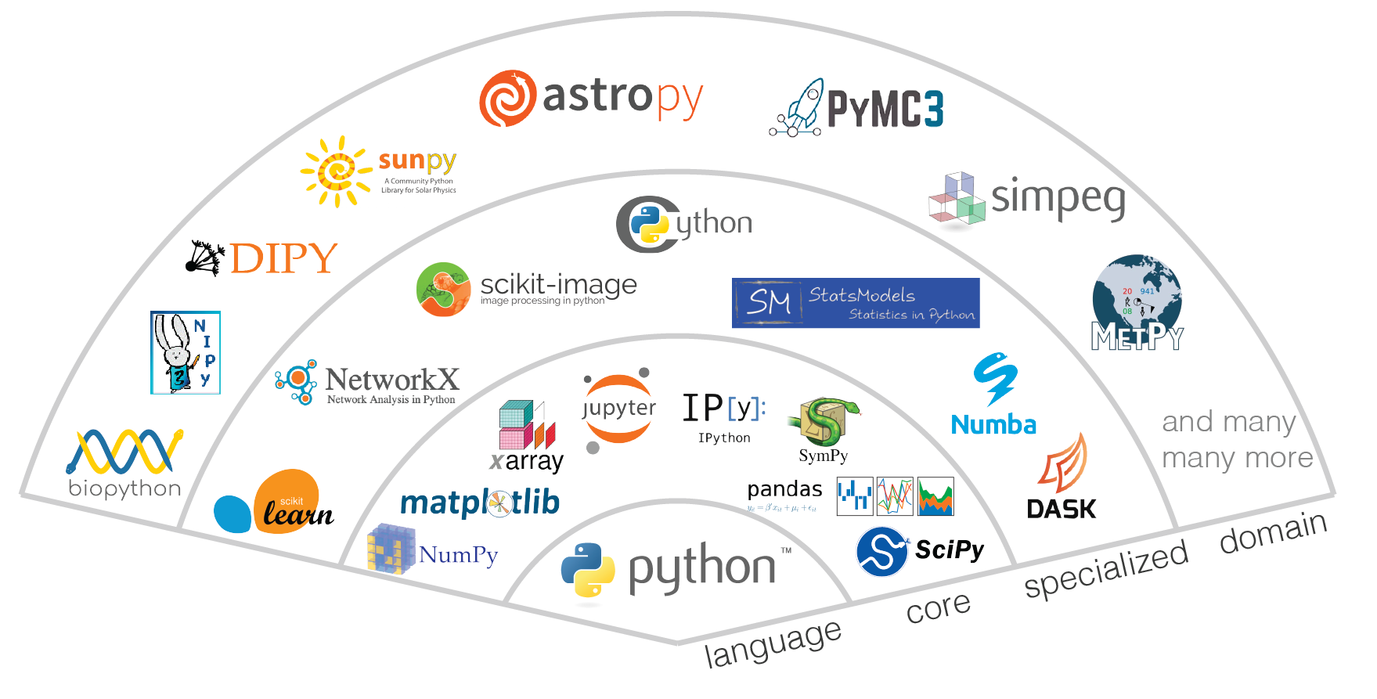
1. Programming Foundations: Learn Python
Why Python?
Most AI tools use Python
Beginner friendly
Huge ecosystem

Slide 6
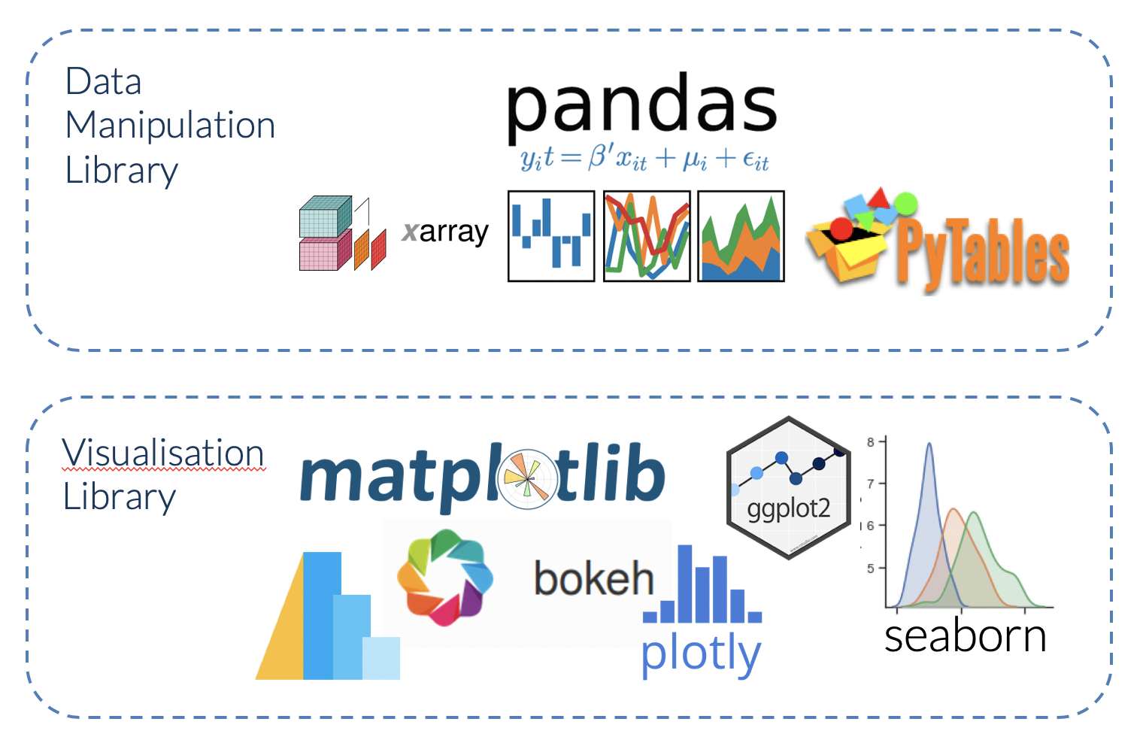
2. Learn Data Handling
AI requires working with data.
Learn:
NumPy
Pandas
Data cleaning
Dat Visualization

Slide 7
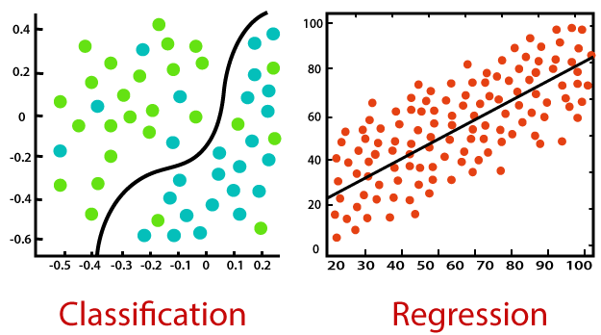

3. Understand Machine Learning Basics
Machine learning is a subset of artificial intelligence that enables computer systems to learn from data.
Understand concepts:
Supervised and Unsupervised learning
Classification and Regression
Overfitting / Underfitting
Train/Test split
Evaluation metrics (Accurcary, F1 etc)

Slide 8
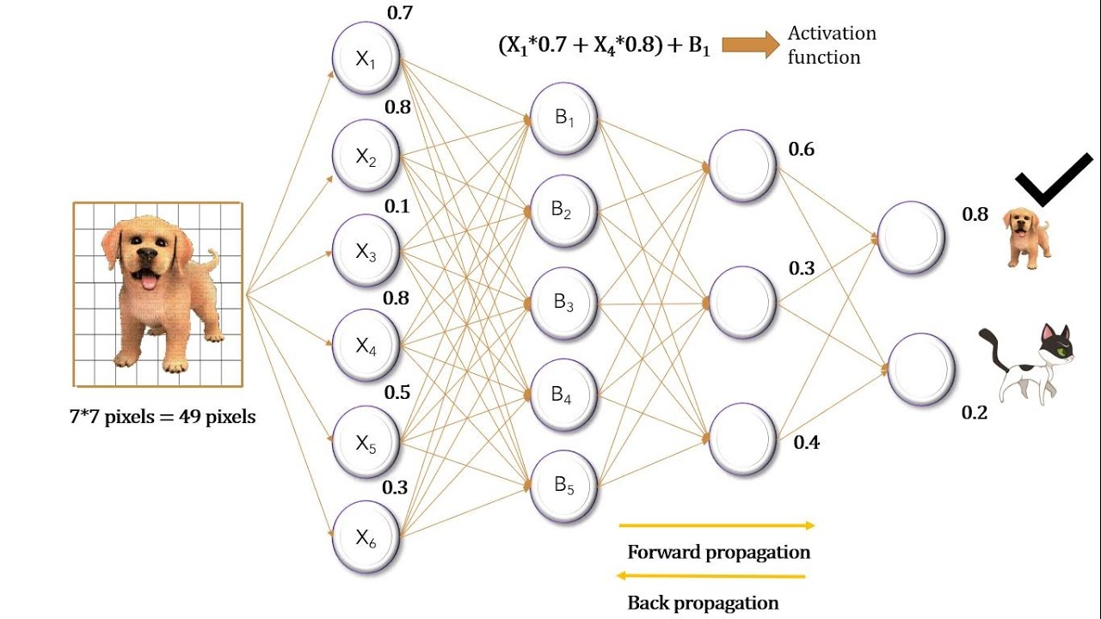


4. Understanding Deep Learning Basics
Deep Learning is a subset of ML that uses neural networks with many layers to learn patterns from large amounts of data.
Understand concepts:
Neural Networks
Layers and Activations
Gradient Descent (How model learns)
Backward and forward propagations

Slide 9
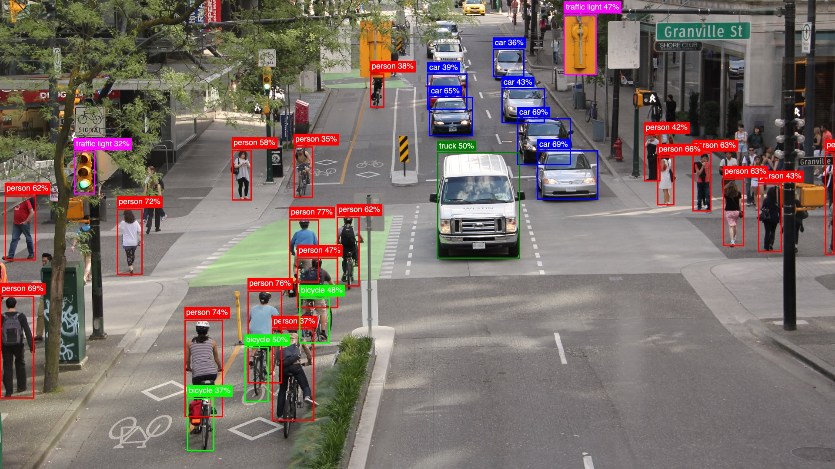


5. Understanding Computer Vision
Key concepts:
Image Processing
Convolutional Neural Network
Image Classification
Imag Segmentation
Object Detection

Slide 10
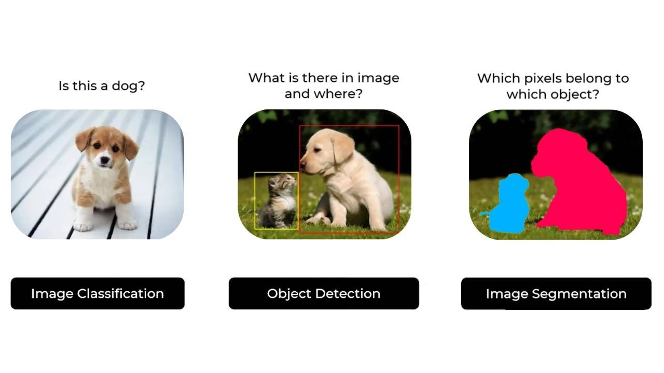
Computer Vision

Slide 11



6. Natural Language Processing Basics
Key Concepts:
Text Processing
Language Models
RNN and Transformers
Text Embedding
Sentiment Analysis
Text Generation

Slide 12
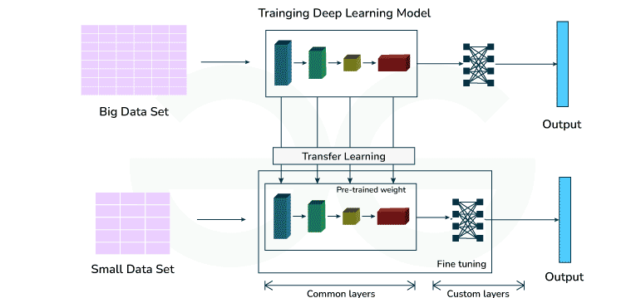
Model Fine Tuning

Slide 13
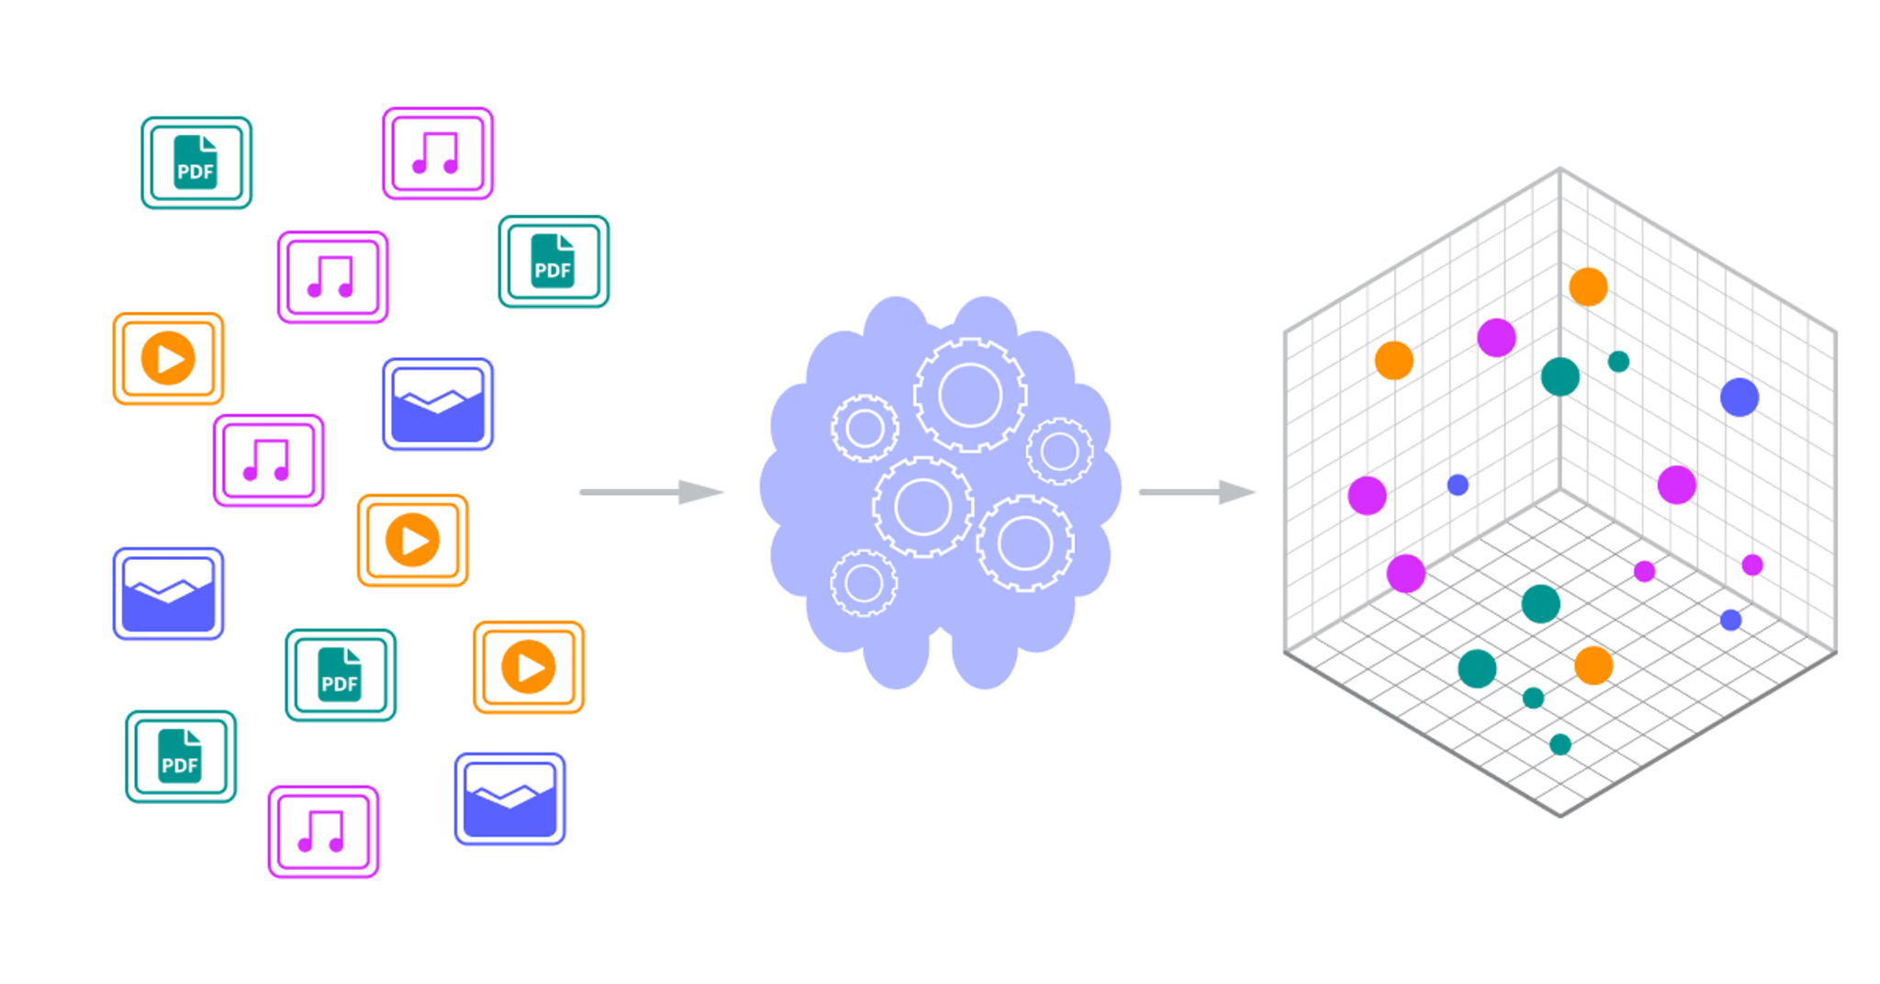
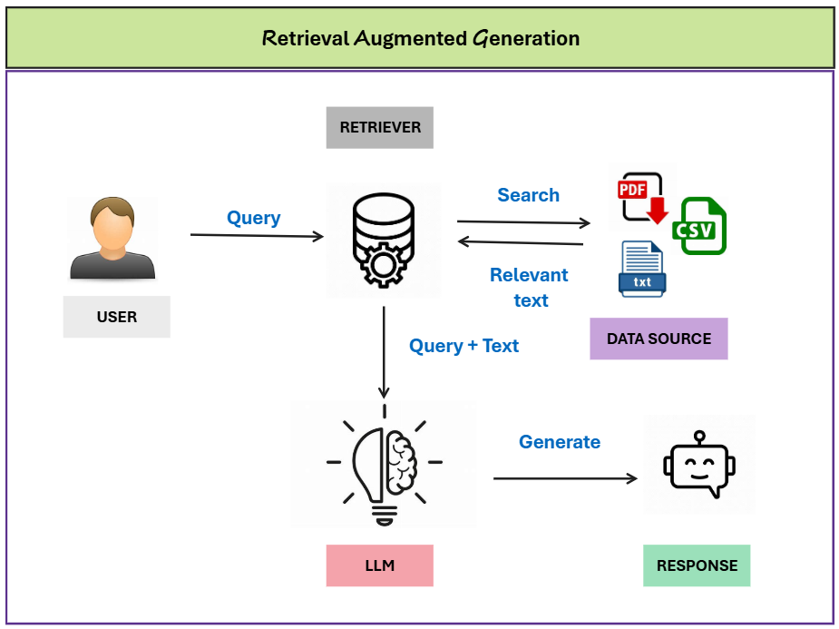
7. Learn Modern AI (LLMs)
Today AI engineering heavily involves:
Large Language Models
Examples: GPT, Gemini, Claude, Llama, Qwen
Learn:
Prompt engineering (React, Structured O/P)
API usage
Embeddings
Vector databases
RAG (Retrieval Augmented Generation)

Slide 14
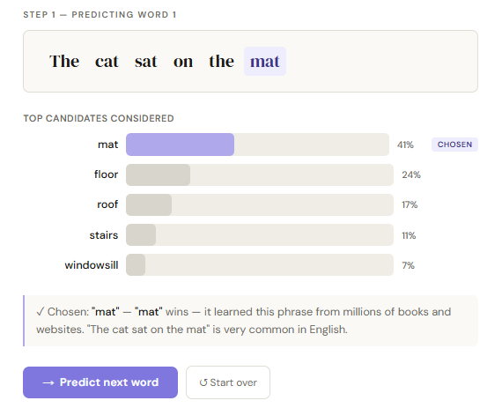
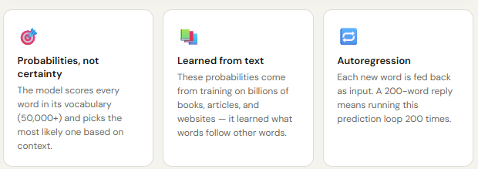
How LLM Works
How LLM Works

Slide 15
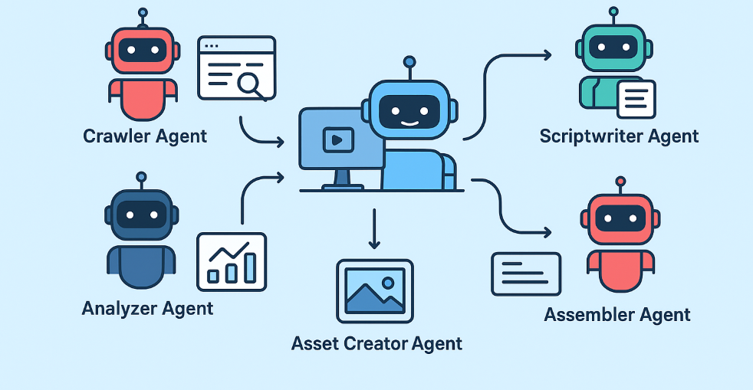



8. Working with Agents
Key Concepts:
Autonomy
Function Calling
Tool Usage
Reasoning & Planning
Model Context Protocol

Slide 16
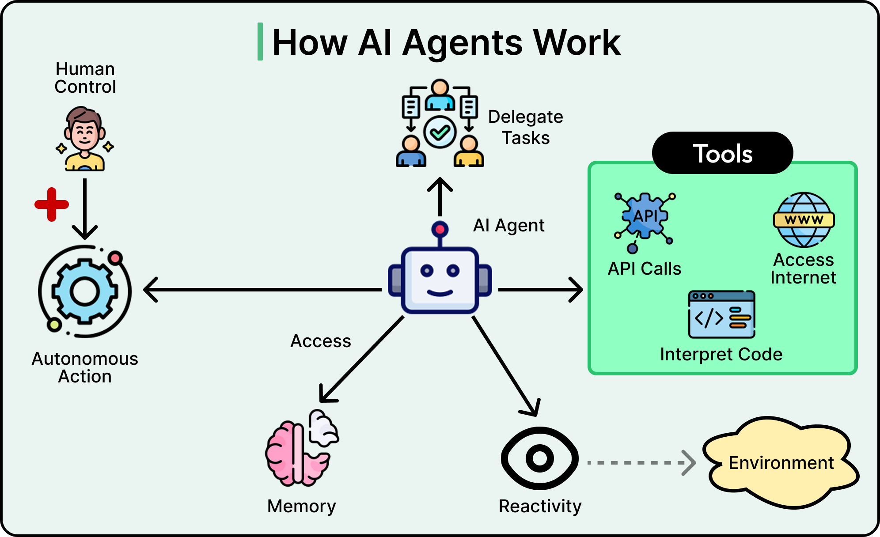
Working with Agents
If LLM = brain - Thinks, reasons, generates text, But cannot act on its own
Then, Agent = brain + body + tools + decision-making loop

Slide 17

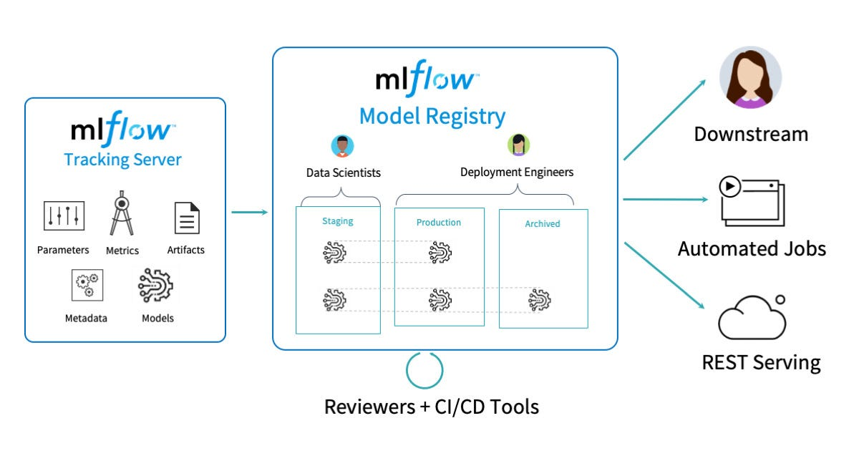


8. MLOps & Production Engineering
Employers hire engineers who can ship
reliable AI Systems, not just notebooks..
Understand concepts:
Fastapi
Git and Github/Gitlab
Docker
Model serving, and monitoring

Slide 18
How to Succeed
Be present in the live class. Actively participating will help you stay on track.
Don’t rely on shortcuts. Focus on learning the fundamentals properly.
Ask questions. Never hesitate to seek help when you need it.
Stay consistent. Keep up with the course lessons and follow along.
Practice regularly. Practice truly makes perfect.

Slide 19
Intro to Machine Learning
What is Machine Learning?
Machine learning is a subset of artificial intelligence (AI) that enables systems to learn from data, identify patterns, and make decisions or predictions without being explicitly programmed for every specific rule
Think of it like this: instead of giving the computer exact instructions, you show it examples, and it figures out the patterns on its own.

Slide 20
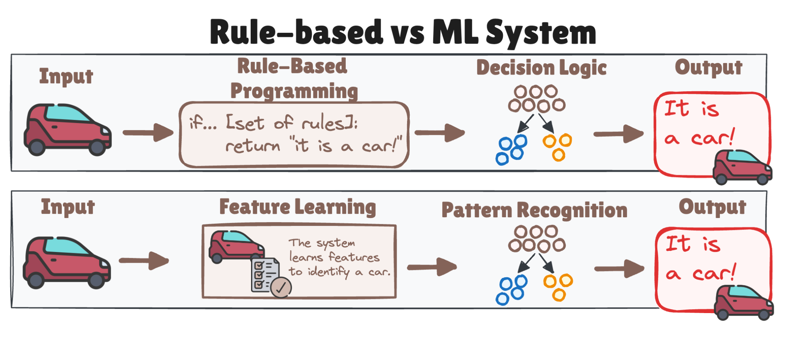
Rule-based vs ML System
Rule Based vs ML System Simulation

Slide 21
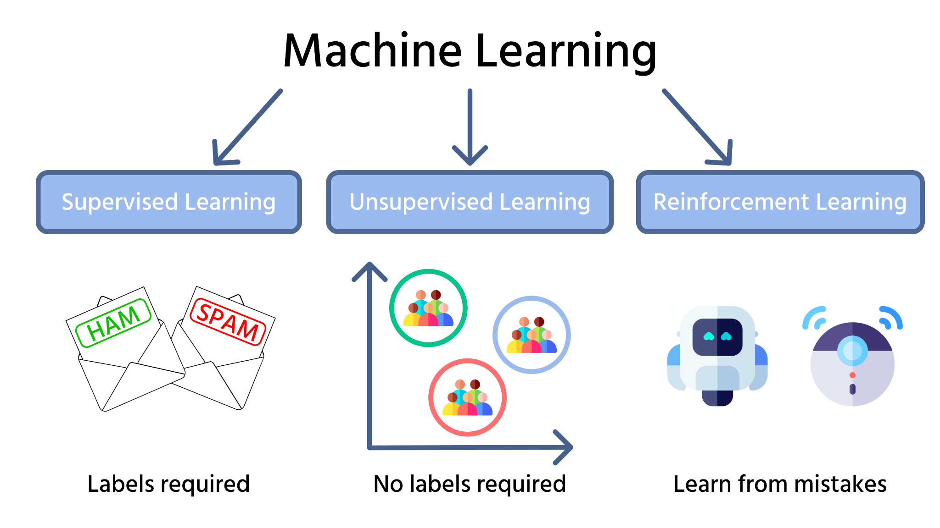
Type of Machine Learning

Slide 22
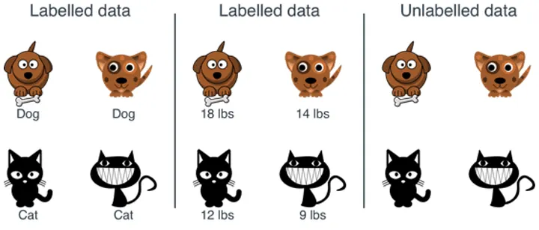
Labelled vs Unlabeled Data

Slide 23
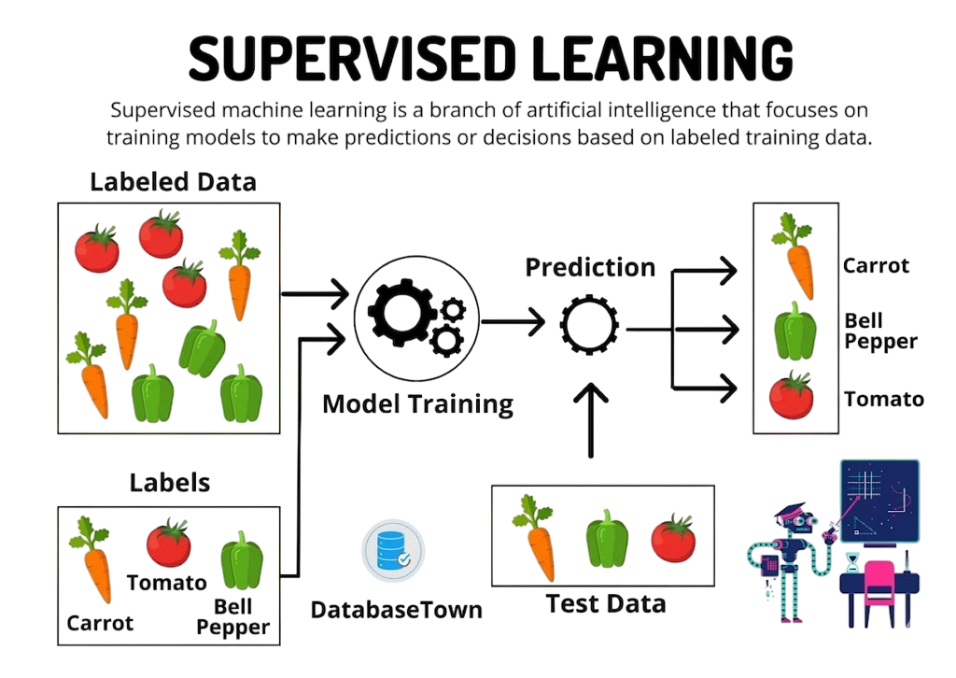
Supervised Learning

Slide 24
Supervised Learning
Supervised Learning Applications:
Email spam detection – Classifying emails as spam or not spam.
Predicting house prices – Using features like size, location, and rooms to estimate price.
Medical diagnosis – Predicting diseases from patient symptoms or test results.
Credit scoring – Deciding whether a person should get a loan based on financial history.

Slide 25
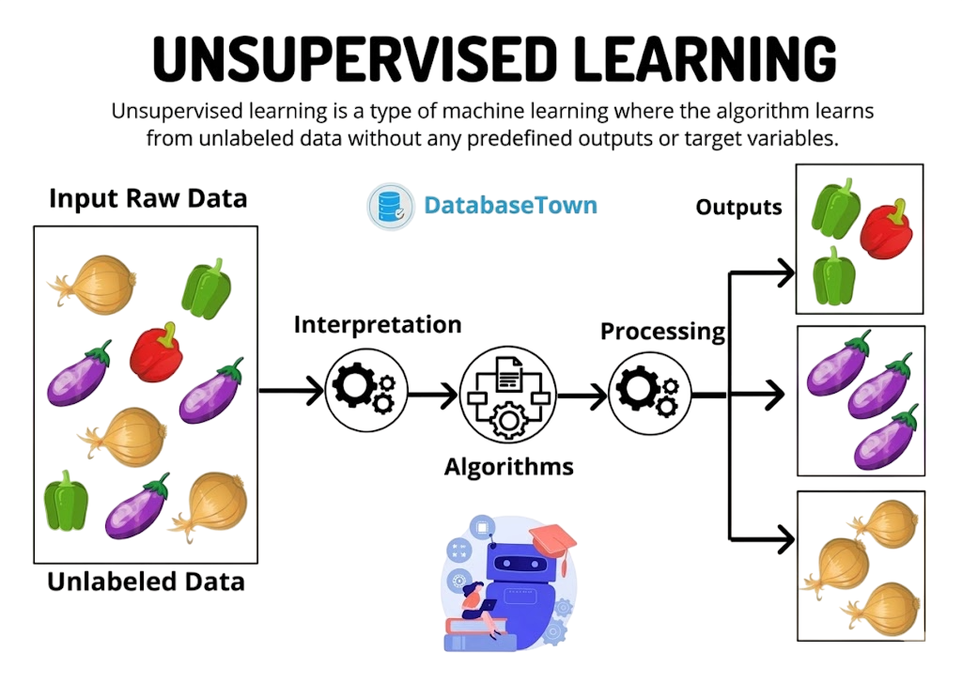
Unsupervised Learning

Slide 26
Unsupervised Learning
Unsupervised Learning Applications:
Customer segmentation – Grouping customers with similar buying habits for marketing.
Market basket analysis – Finding products that are often bought together (association rules).
Anomaly detection – Detecting unusual patterns, like fraud in transactions.
Document clustering – Organizing news articles or documents into topic-based groups.

Slide 27
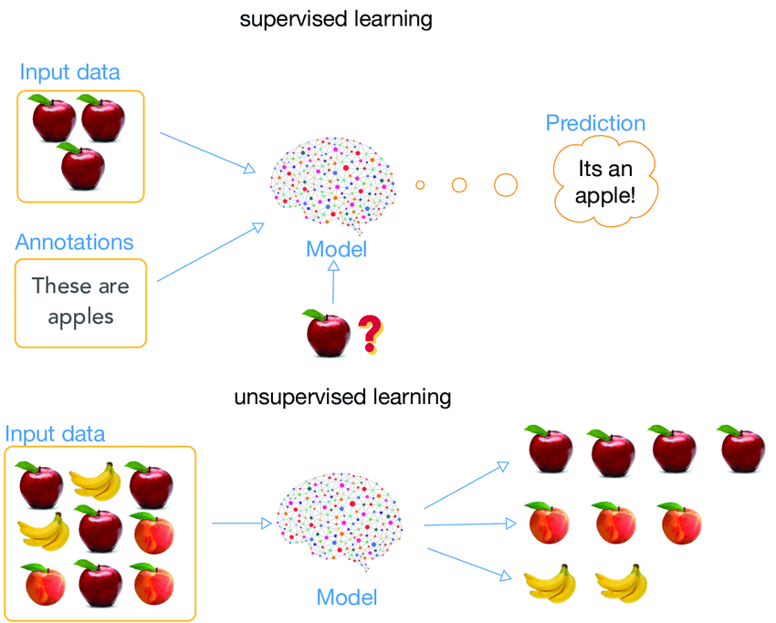
Supervised vs Unsupervised

Slide 28
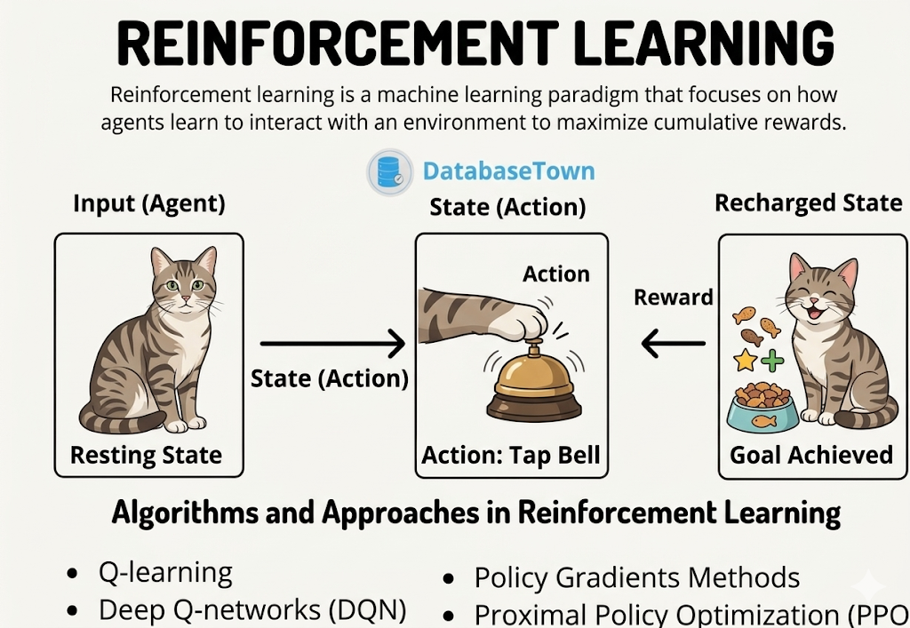
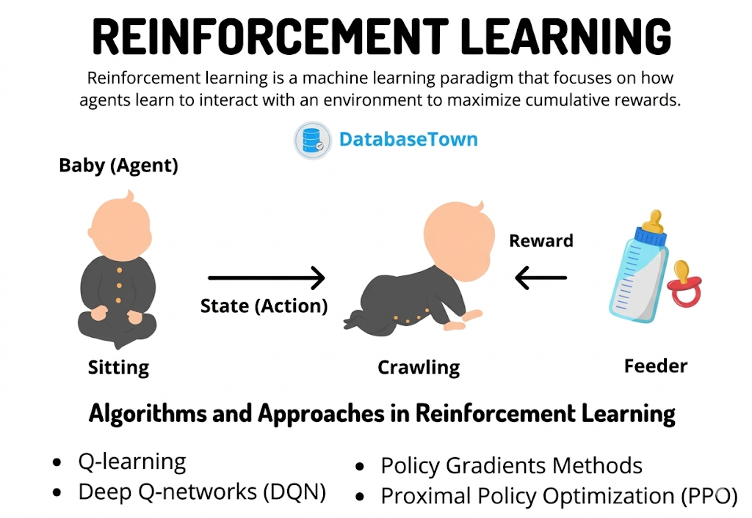
Reinforcement Learning

Slide 29
Reinforcement Learning
Reinforcement Learning Applications:
Game playing – Teaching AI to play games like Chess, Go, or video games (e.g., AlphaGo, OpenAI Five for Dota 2).
Robotics – Teaching robots to walk, pick objects, or navigate in complex environments.
Recommendation systems – Optimizing recommendations dynamically based on user interactions.
Autonomous vehicles – Training self-driving cars to make decisions in traffic safely.
Resource management – Optimizing energy usage or traffic signals for efficiency.

Slide 30


Teaching a Robot how to Walk

Slide 31
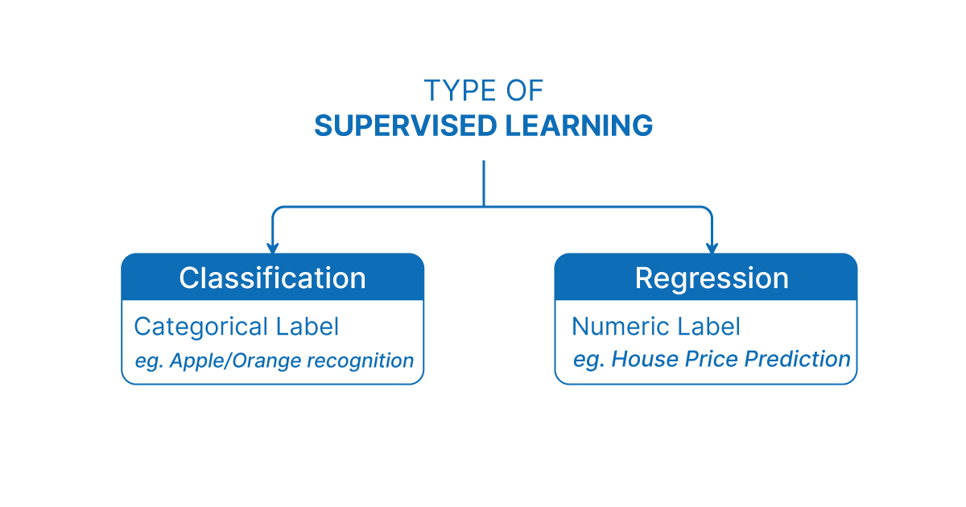
Type of Supervised Learning

Slide 32
Classification
Classification
Goal: Predict a category or class.
Applications:
  Email spam detection (spam or not spam).
  Diagnosing diseases (disease A, disease B, or healthy).
  Sentiment analysis (positive, negative, neutral).
  Handwriting or image recognition (digits, letters, objects).

Slide 33
Regression
Regression
Goal: Predict a continuous number.
Applications:
  Predicting house prices based on size, location, and rooms.
  Forecasting stock prices or sales.
  Estimating temperature or weather conditions.

Slide 34
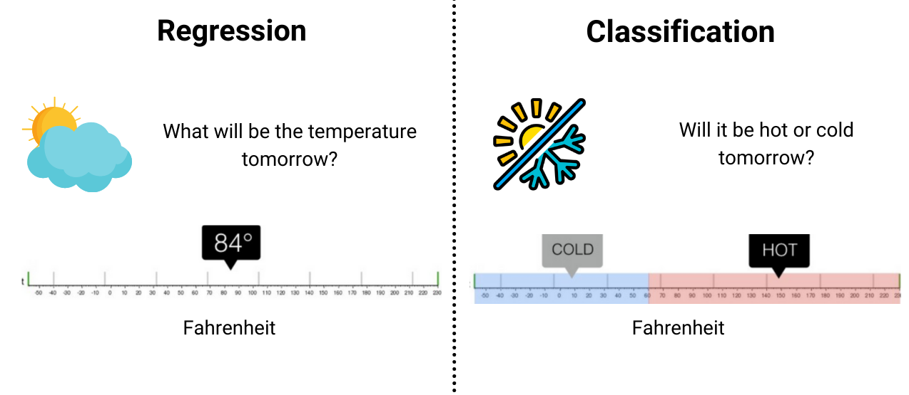
Classification Vs Regression

Slide 35
Features and Labels
Features (Input variables)
Features are the input data used to make predictions
They describe the properties or characteristics of each example
Usually denoted as X
📌 Example:
If you're predicting house prices:
Size (sq ft)
Number of bedrooms
Location
➡️These are features
Labels (Target / Output)
Labels are the correct answers you want the model to learn
They represent what you're trying to predict
Usually denoted as y
📌 Example:
House price
➡️This is the label
Labels are also called “targets”

Slide 36
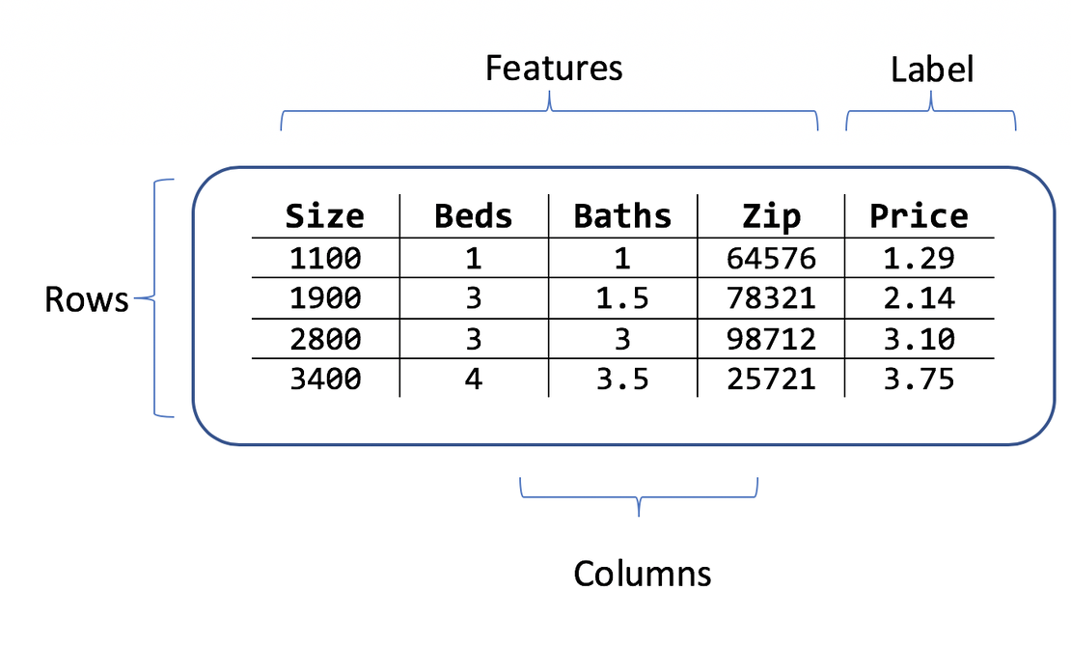
Features and Labels
Regression Dataset

Slide 37
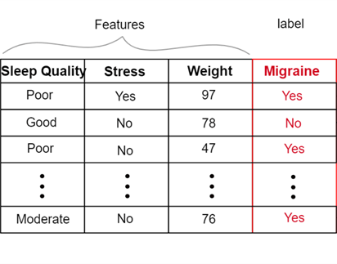
Features and Labels
Classification Dataset

Slide 38
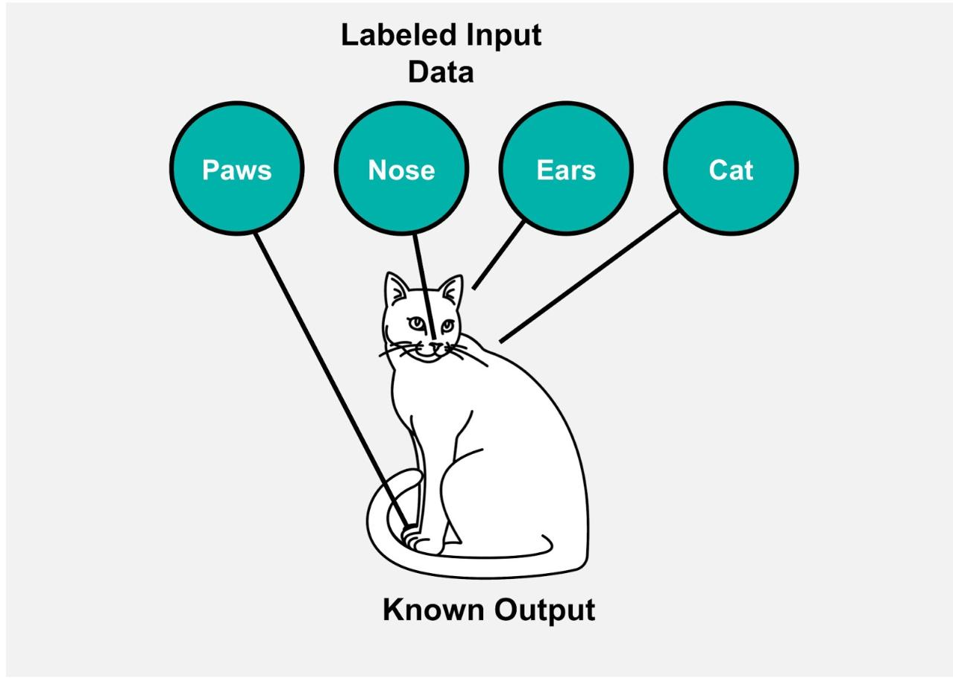
Features and Labels
In this image, what are the features and what is the label?

Slide 39
Types of Data
1️⃣ Based on Structure
This is about how data is stored
Structured data → tables (rows & columns)
Unstructured data → text, images, audio, video
Semi-structured data → JSON, XML
2️⃣ Based on Data Type (Values)
This is about what kind of values the data contains
Numerical
  Continuous
  Discrete
Categorical
  Nominal
  Ordinal

Slide 40
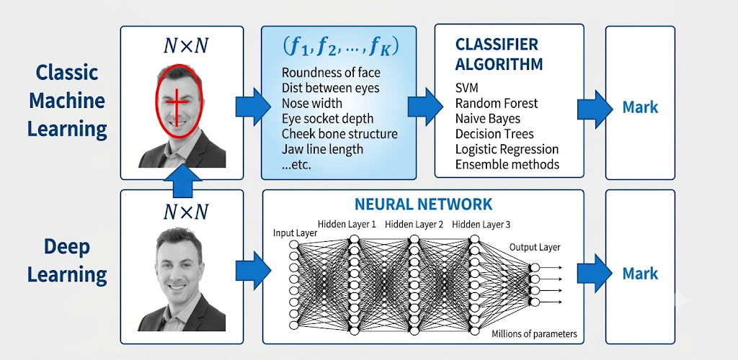
Classical ML vs Deep Learning

Slide 41
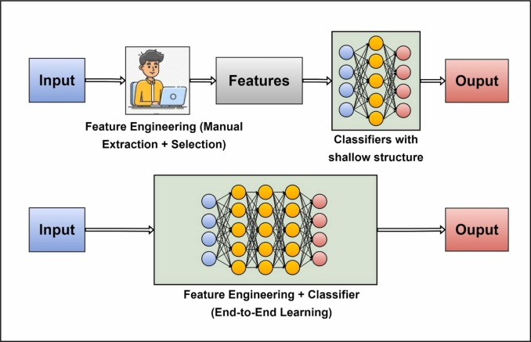

Slide 42
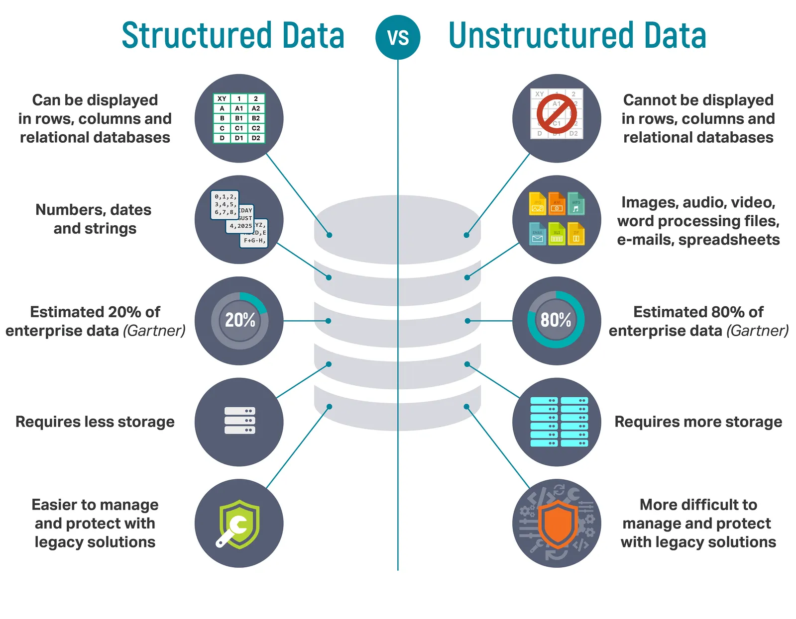
Types of Data k21academy

Slide 43
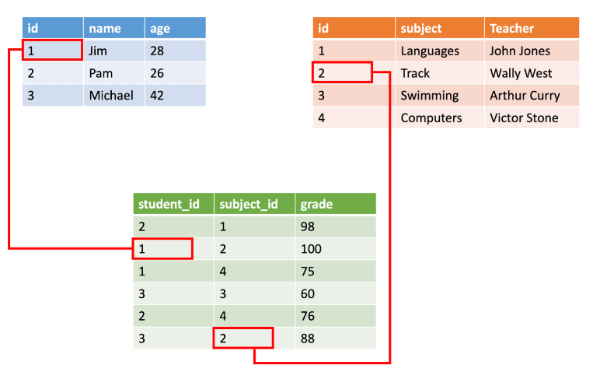
Structured Data

Slide 44
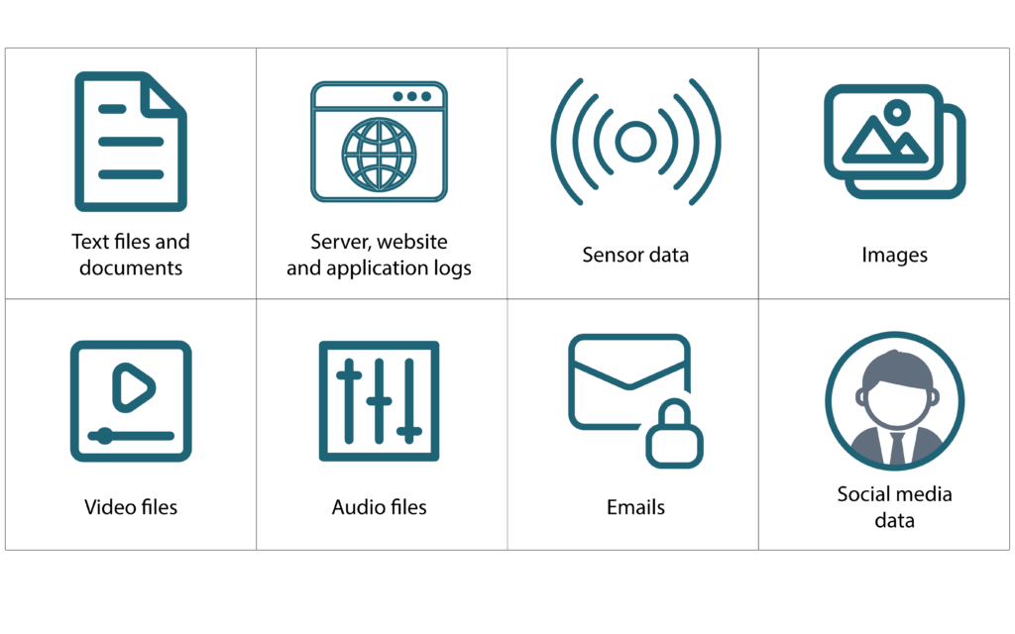
Unstructured Data

Slide 45
Thank you!

